Slide 1
EDA and ML on Prosper Data (ongoing)
D7: Crowdfunding Default/Fraud Detection
Nadi Serhan Aydın, PhD, FRM

Slide 2
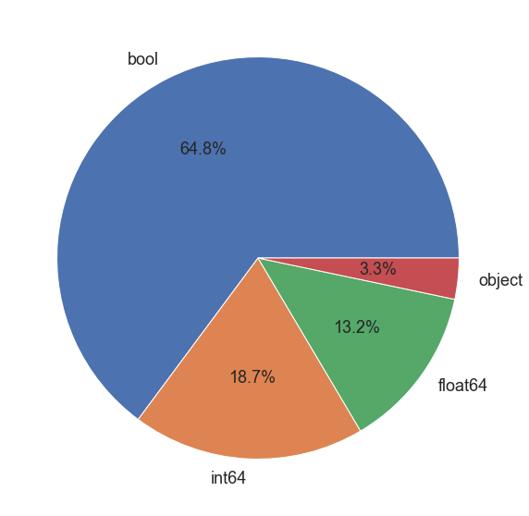
Data pre-processing

Slide 3
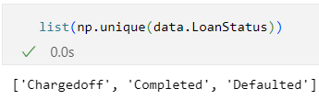
Data pre-processing
Initial data shape: (113937, 81)
Target variable: LoanStatus
Produce % columns out of some absolute value columns
Remove labels that are not logical or have scarce data: (55084, 91)
Remove features with >50% of data missing
Drop remaining rows with at least with one NaN value: (18506, 67)
Convert Boolean and categorical variables to integers
Apply standard scaler and remove outliers
Notes:
High score

Slide 4
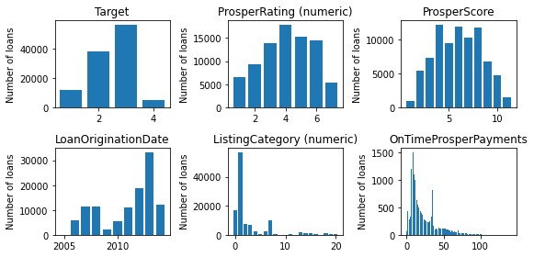
Pre-processed data
Notes:
Data is imbalanced

Slide 5
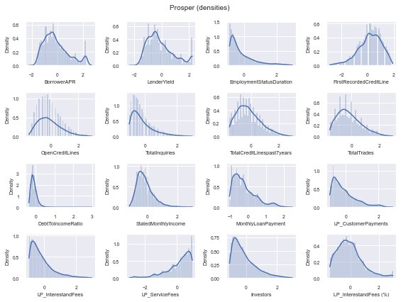
Empirical densities of select features
Notes:
Can be provided as spectral inputs from the frequency domain

Slide 6
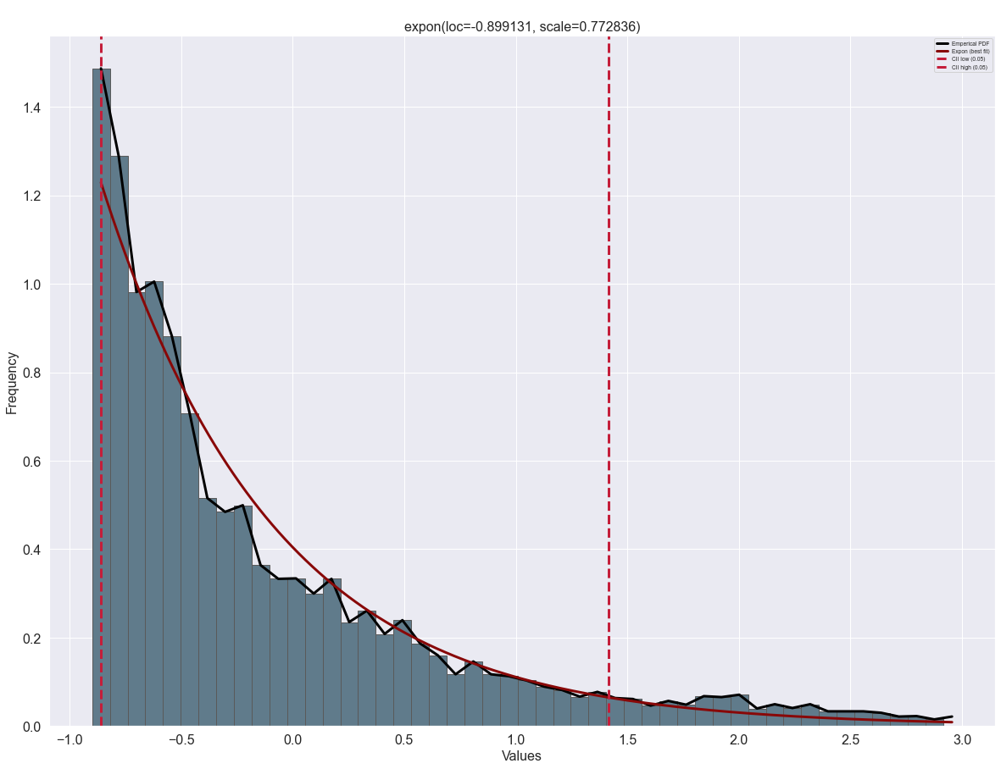
Estimated densities of select features

Slide 7
Feature selection
Feature selection is used when we you know the target variable (Supervised Learning).
For Unsupervised Learning, there is no exact technique.
Dimensionality Reduction can be used to reduce the number of features and give us the core set of features which can explain most of the variability in the dataset.
The features would be derived from the existing features and might or might not be the same features.
There are different techniques which are available for doing so:
PCA, Linear discriminant analysis, Non-negative Matrix Factorization, Generalized discriminant analysis, etc.
Notes:
is it possible to do feature selection for unsupervised machine learning problems? - Data Science Stack Exchange

Slide 8
Feature selection
One feature selection scheme is to select features that correlate strongest to the classification variable. This has been called maximum-relevance selection.
Many heuristic algorithms can be used, such as the sequential forward, backward, or floating selections.
On the other hand, features can be selected to be mutually far away from each other while still having high correlation to the classification variable.
This scheme, termed as Minimum Redundancy Maximum Relevance (MRMR) selection has been found to be more powerful than the maximum relevance selection.
Chi2, ANOVA, Kruskal Wallis can also be used.
Notes:
Minimum redundancy feature selection - Wikipedia

Slide 9
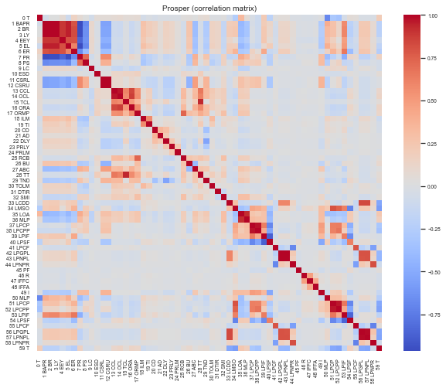
Raw correlation matrix
66 features + LoanStatus

Slide 10
Raw correlation matrix
Let’s keep in mind that correlation is a measure of linear relationship
An ML model can discover non-linear relationships as well
We further refine the feature matrix through Maximum Relevance Minimum Redundancy (MRMR)

Slide 11
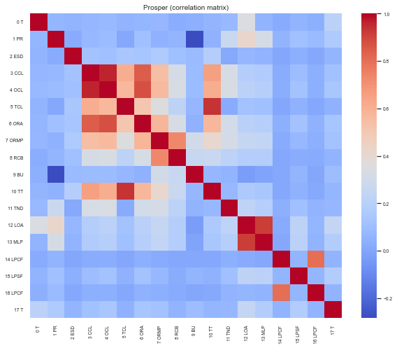
Refined correlation matrix
12 features + LoanStatus

Slide 12
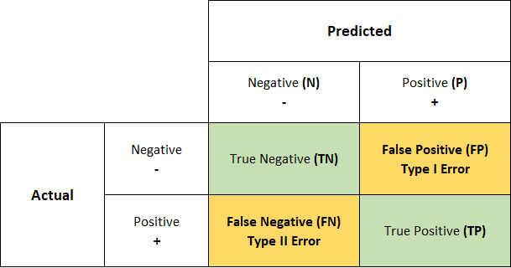
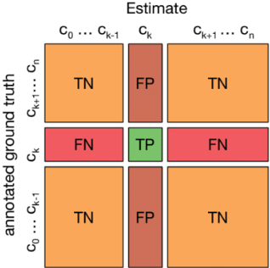
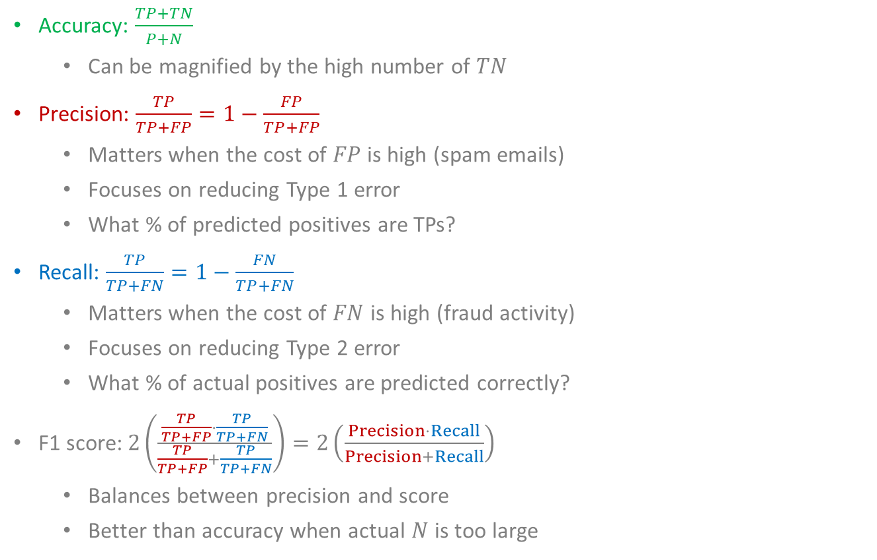
Performance metrics
Accuracy: $\frac{TP+TN}{P+N}$
Can be magnified by the high number of $TN$
Precision: $\frac{TP}{TP+FP}=1−\frac{FP}{TP+FP}$
Matters when the cost of $FP$ is high (spam emails)
Focuses on reducing Type 1 error
What % of predicted positives are TPs?
Recall: $\frac{TP}{TP+FN}=1−\frac{FN}{TP+FN}$
Matters when the cost of $FN$ is high (fraud activity)
Focuses on reducing Type 2 error
What % of actual positives are predicted correctly?
F1 score:$2\left(\frac{\frac{TP}{TP+FP}⋅\frac{TP}{TP+FN}}{\frac{TP}{TP+FP}+\frac{TP}{TP+FN}}\right)=2\left(\frac{Precision⋅Recall}{Precision+Recall}\right)$
Balances between precision and score
Better than accuracy when actual $N$ is too large
Notes:
Accuracy is a trick measure as long as you have an highly imbalanced data with rare events (with high conditional impact)
Accuracy, Precision, Recall or F1? | by Koo Ping Shung | Towards Data Science

Slide 13
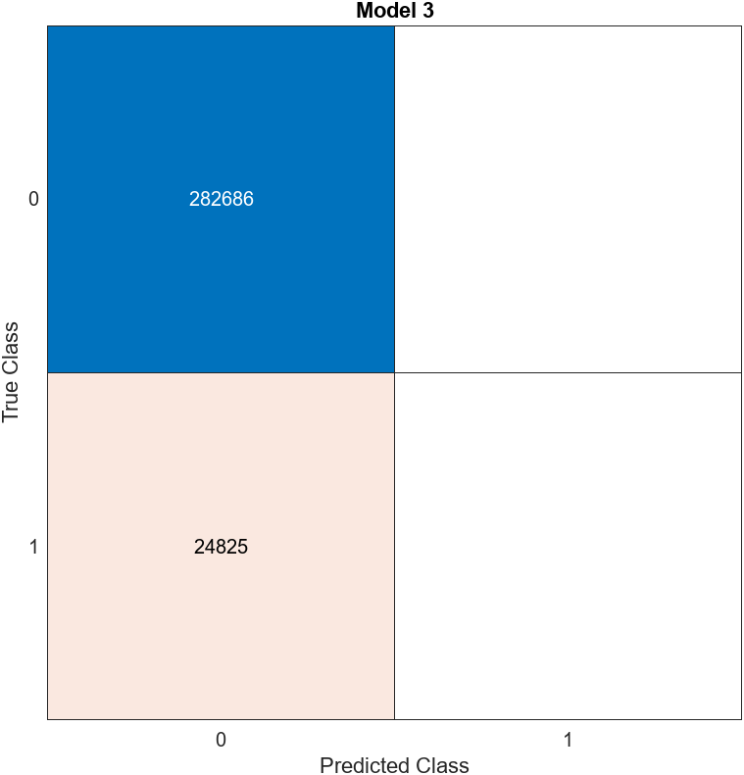
Home Credit
Fraud/default models cannot have high Type II error (poor Recall)
Accuracy 91.9% vs Recall 0% (k-fold cross validation)
Notes:
Is it really crowdfunding? “…direct investment from credit company Home Credit to Zonky P2P consumer lending platform. Home Credit wanted to diversify its credit activities into trendy P2P loan financing.” Current State of Crowdfunding in Czech Republic 2016 - CrowdfundingHub

Slide 14
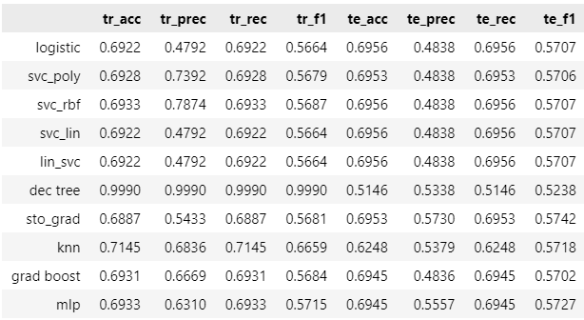
Performance results
Without re-sampling (80-20 train-test)
Notes:
Just preliminar results, without any hyperparameter tuning anything similar

Slide 15
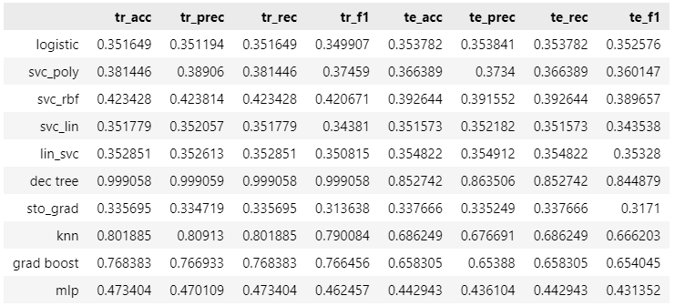
Performance results
Random over-sampling (80-20 train-test)
Notes:
Home credit data has much more explanatory power

Slide 16
Research directions
Pre-/post-fraud-policy change comparison
Not too much related to ML
Try labeling existing data
Fraud is a legal issue (use of model-based labels needs caution)
Fraud indicators (even quantitative ones) hardly apply to historical data
Work on target variables at hand just to showcase that data has some explanatory power (and if possible use them as proxies for fraud)
…

